Slide 1

Housing In Denver
(39.747070, -104.997620)
Eric Lahart

Slide 2
Abstract
Gather data from Zillow to understand the relationship between distance to downtown Denver and price.
I discovered my initial assumption was not valid, I analyzed other features of the data.
I created regression models based off highly correlated features to the price of the house to determine the if the model could accurately predict the price of the house.
My models were able to compute a R squared of 0.98 and RMSE of 40,059.

Slide 3
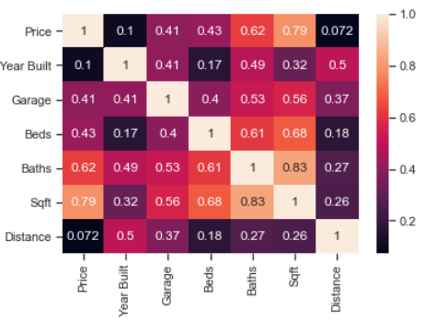
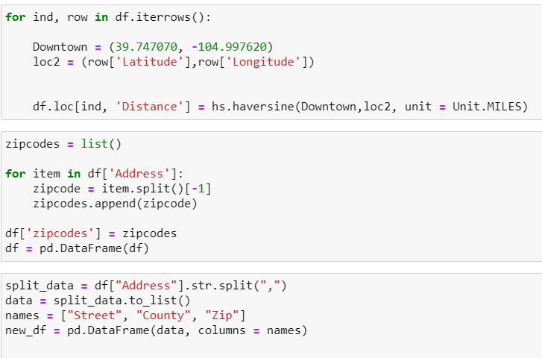
Introduction
Current housing data from Zillow
Determine the relationship between distance and cost of living in Denver
I used scatter plots, geographical maps, and correlation matrix to analyze the problem

Slide 4
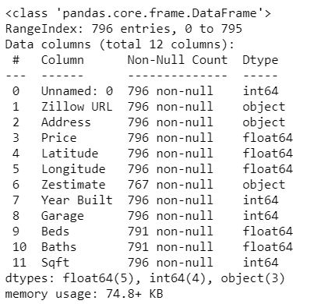
Problem
Buying a house can be a stressful time in your life.
Especially, buying a house in an unfamiliar area.
I wanted to building a program that could help determine where to live with taking in account your commute.

Slide 5
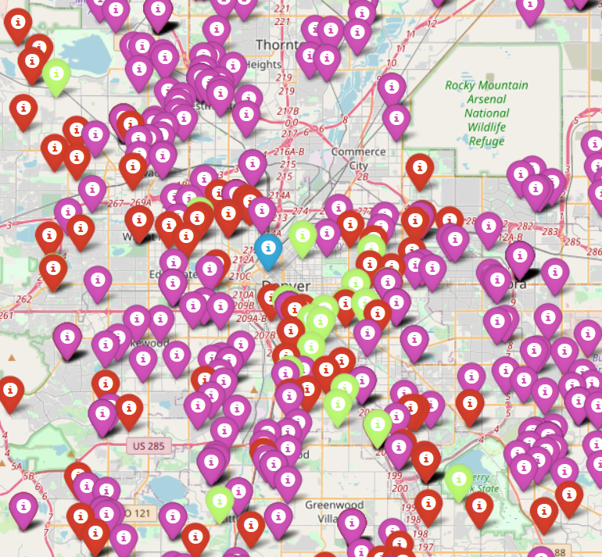
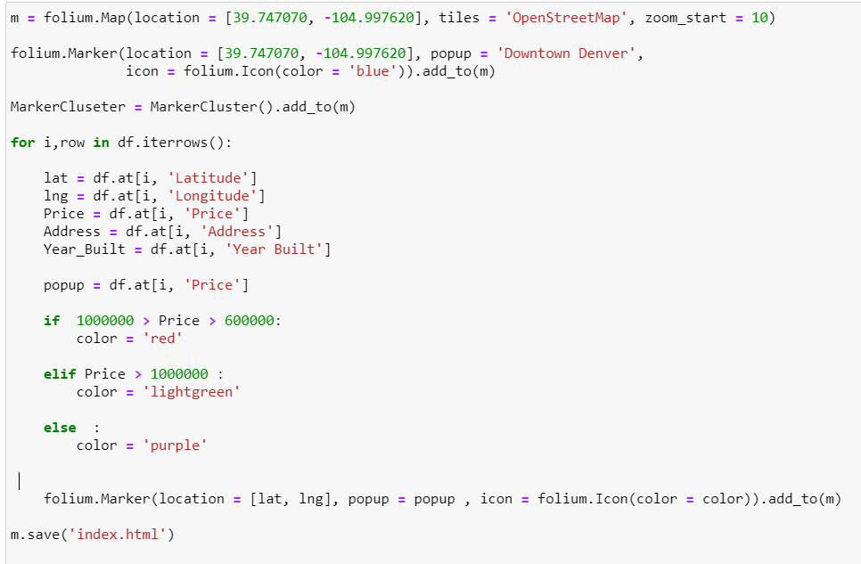
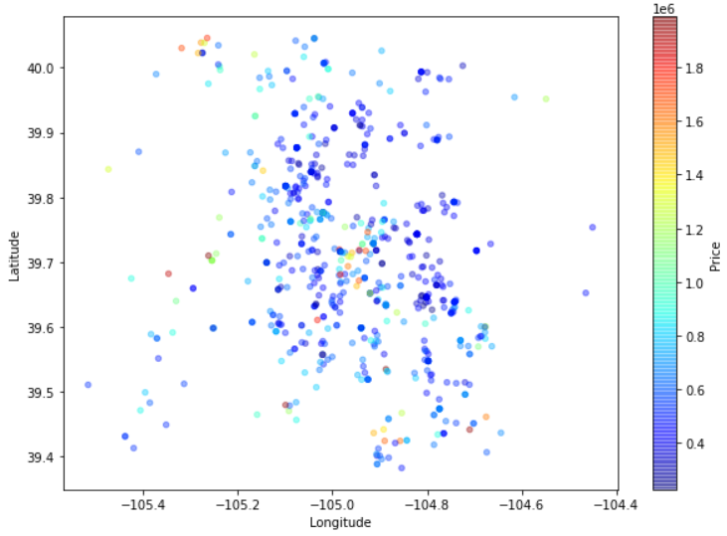
Purpose
The purpose of the project is to determine the if there is a strong relationship between distance and the price of the house and if you can predict the price of the house off that feature.

Slide 6
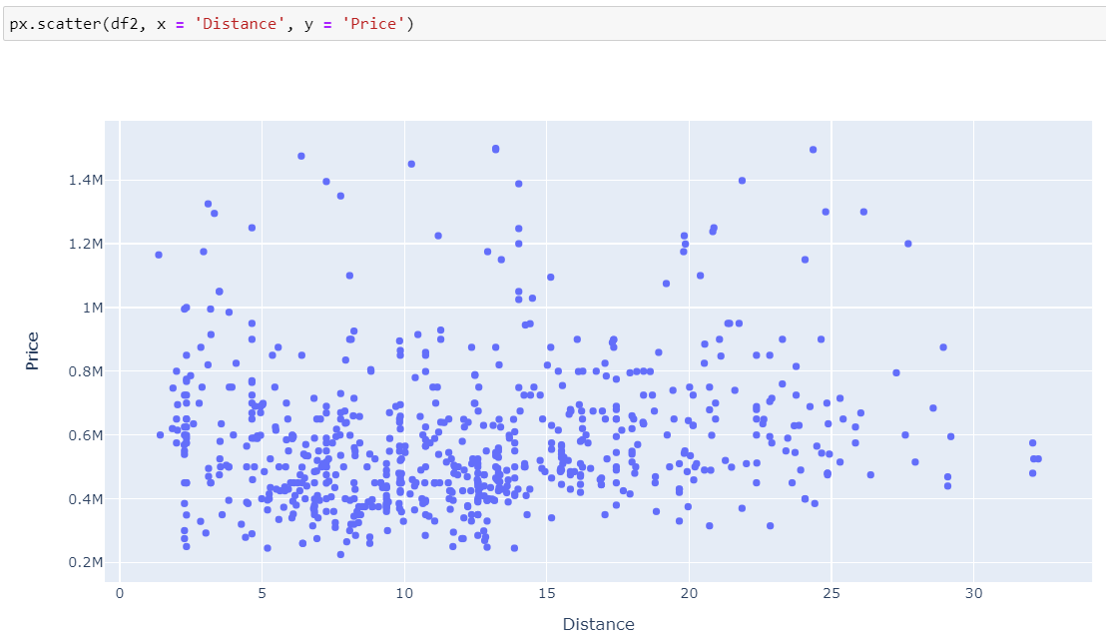
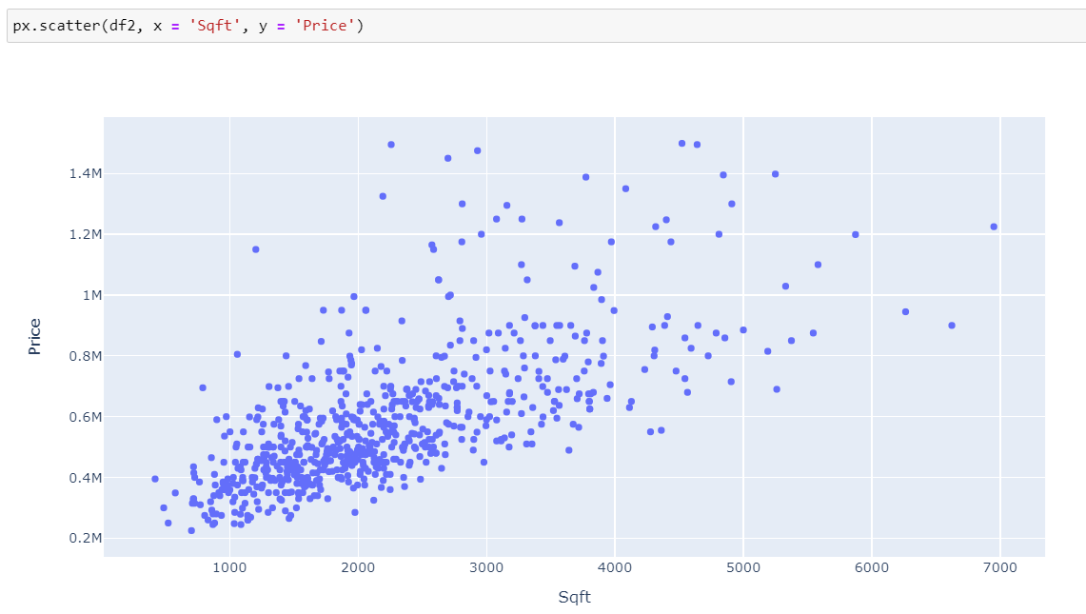
Project Description
After discovering a poor correlation between Distance and Price. I analyzed the Price with other features like square feet.

Slide 7
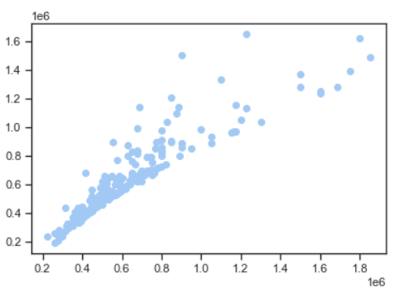
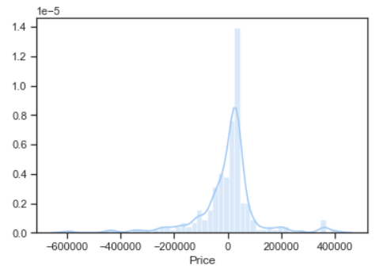
Project Description
Using the features: square feet, price per square feet, beds, baths, garage, and neighborhood I create a models to predict the price of a house.
Linear Regression
- R squared: 0.84
- RMSE: 117,205
Random Forest Regressor
- R squared: 0.97
- RMSE: 47,809
Gradient Boosting Regressor
- R squared: 0.98
- RMSE: 40,059

Slide 8
Conclusion
There is a clear relationship between square feet and price. However, there is not as clear of a relationship between distance to price.
Opportunities for further research:
Neighborhoods
Extracurriculars
School ratings
Crime Data

